Slide 1
Europe refugee crisis Prayer pointers
‘Europe is facing the worst refugee crisis since the Second World War’ (Dimitris Avramopoulos, EU official in charge of migration)
At least 350,000 migrants have arrived in Europe by sea so far this year (source: UN)

Slide 2
Europe refugee crisis Prayer pointers
2,600 have died or gone missing while crossing the Mediterranean Sea (source: IOM)
The Salvation Army is responding across Europe (source: sar.my/europerefugees)

Slide 3
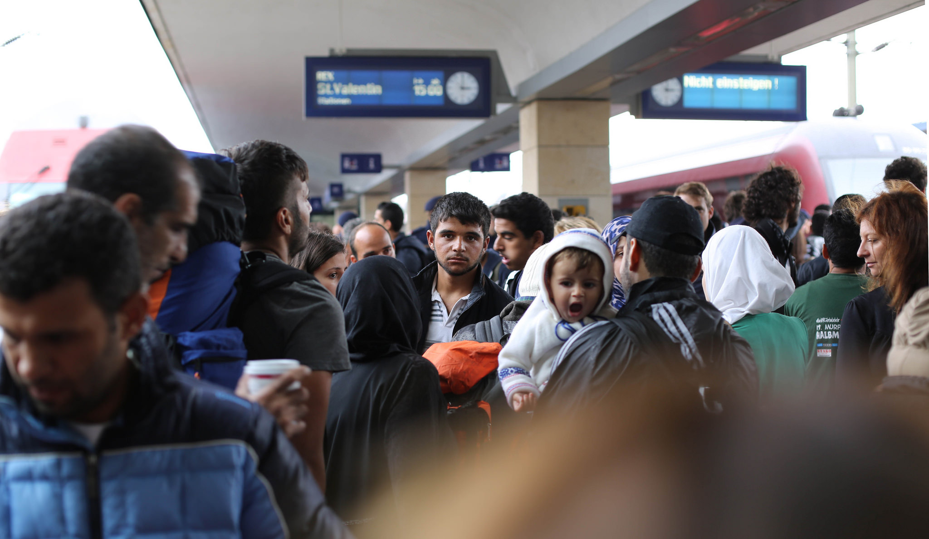
Photo: Josh Zakary (Creative Commons)
Pray for asylum seekers and refugees who have left loved ones in their country of origin and who are at risk of harm

Slide 4
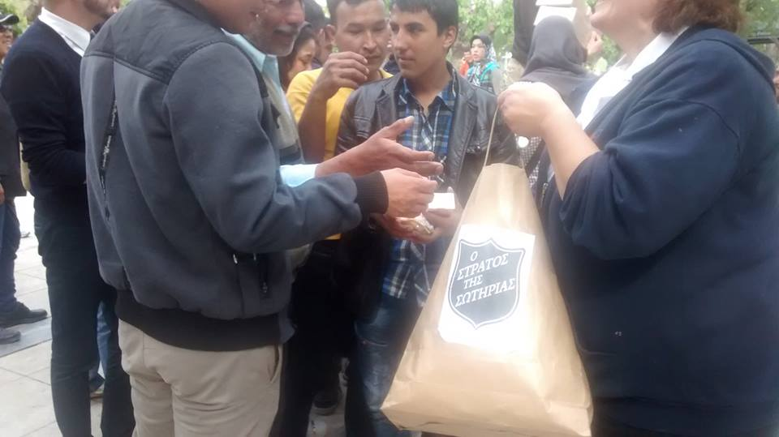
Photo: The Salvation Army in Greece
Pray that refugees would receive all the help they need, so they can live the life of freedom and fullness God intends

Slide 5
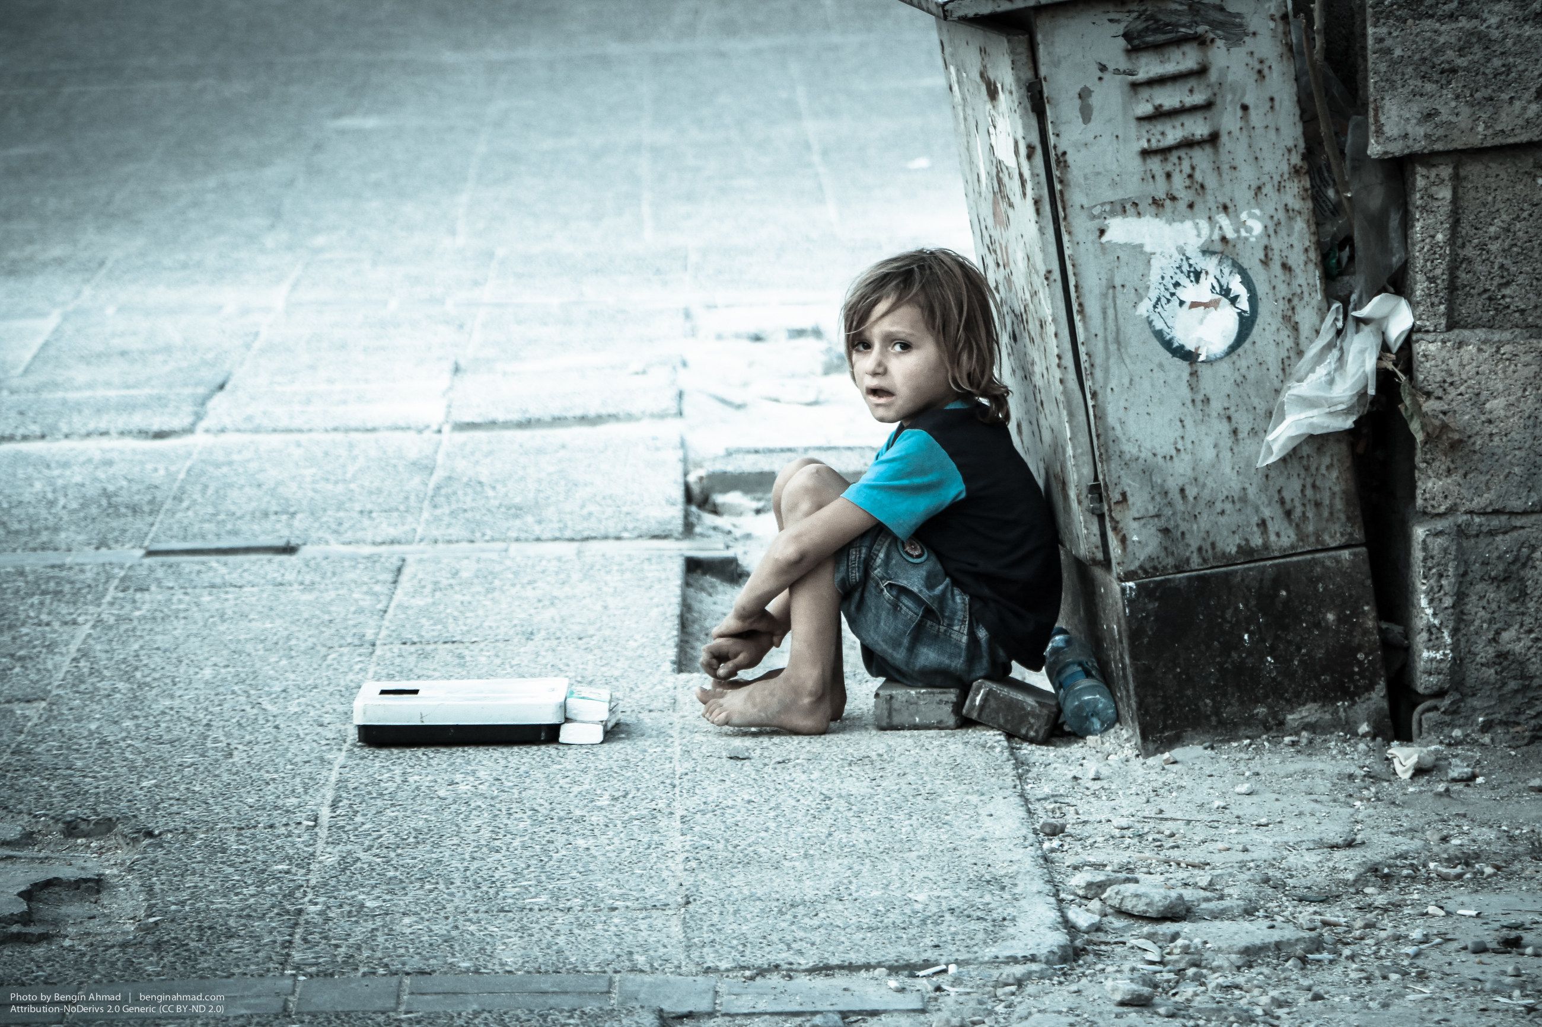
Photo: Bengin Ahmad (Creative Commons)
Pray for asylum seekers and refugees who have experienced trauma and persecution

Slide 6
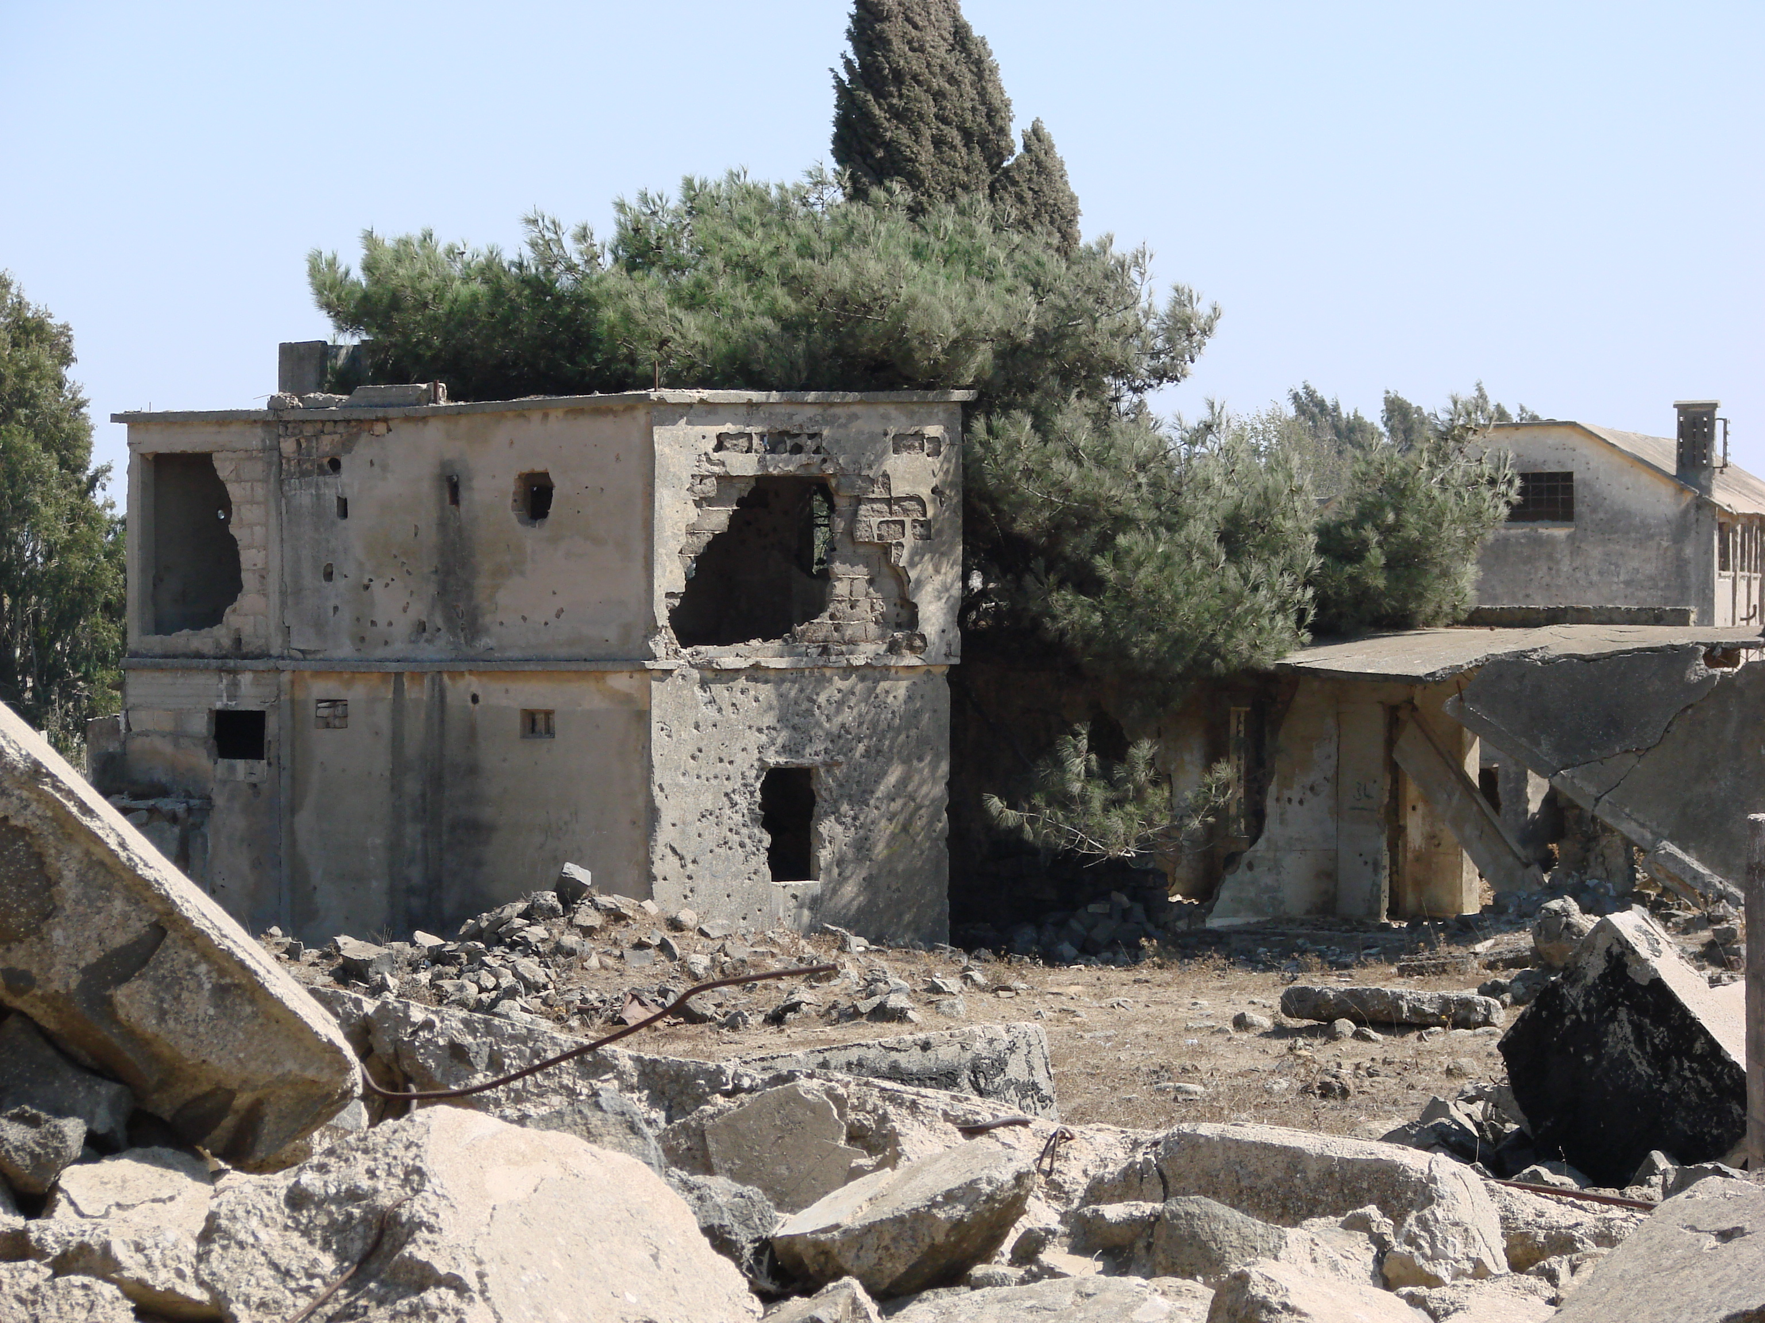
Photo: Michael Goodine (Creative Commons)
Pray for an end to the conflicts in Syria, Afghanistan, Iraq, Somalia, Pakistan, Eritrea, Libya and so many other countries

Slide 7
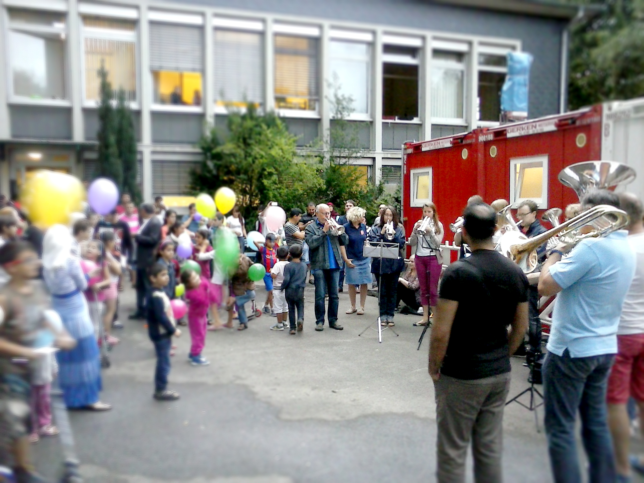
Photo: The Salvation Army in Solingen, Germany
welcomes refugees to their town
Thank God that EVERYONE is accepted in his sight and loved by him

Slide 8
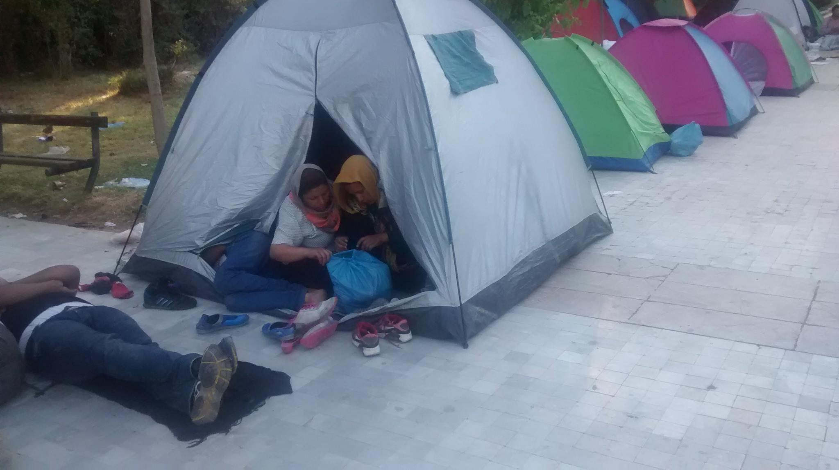
Photo: The Salvation Army in Greece
Pray that The Salvation Army’s provision of food, shelter, accommodation, blankets, clothing, hygiene supplies would be effective

Slide 9
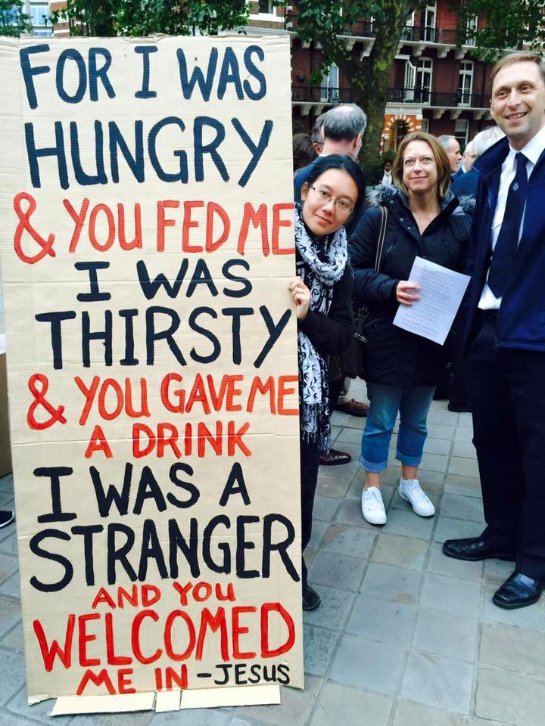
The biblical mandate
‘Look, the tears of the oppressed with no one to comfort them…’ (Eccl 4:1)
‘The LORD watches over them’ (Ps 146:9)
‘Bring good news to the poor … let the oppressed go free’ (Luke 4:16ff)

Slide 10
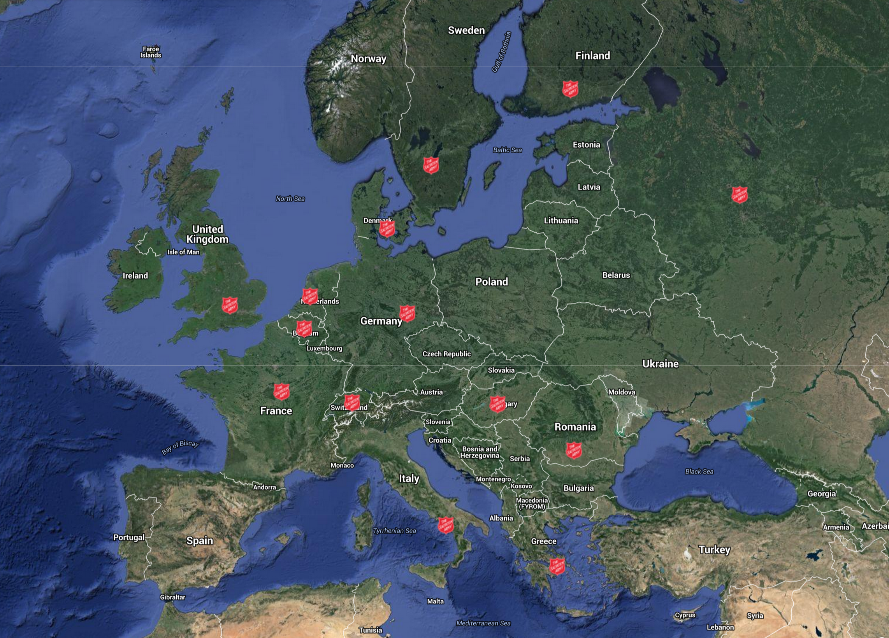
Pray for The Salvation Army’s refugee response right across Europe. Stay informed at sar.my/europerefugees
Source: Google/IHQ

