Slide 1


Slide 2



Being there when people need us most
We offer care and compassion as a sacred encounter with transformative potential

Slide 3
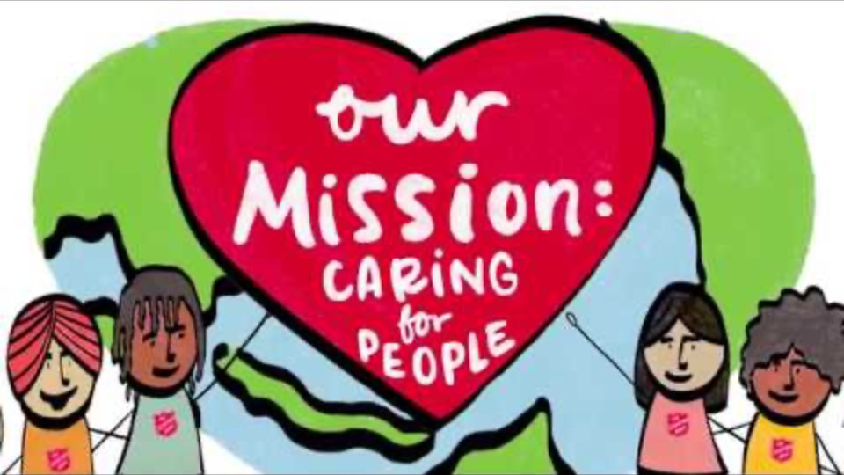

Slide 4
When Jesus was asked what is the greatest commandment, he replied “‘Love the Lord your God with all your heart and with all your soul and with all your mind’ … and the second is like it: ‘Love your neighbour as yourself’”
MATTHEW 22:36–39

Slide 5
“God created human beings in his own image. In the image of God he created them; male and female he created them”
GENESIS 1:27, NLT

Slide 6
“This is how we know what love is: Jesus Christ laid down his life for us. And we ought to lay down our lives for our brothers and sisters”
1 JOHN 3:16

Slide 7
Think
What are some of the challenges or barriers that we face in caring for people in the same way as Jesus?
How have I experienced people caring for me?
Discuss
How have you seen others show care for people?
What are some ways that we can work together to show God’s love to others?
What are some of the challenges we face in caring for people?

Slide 8
Pray
Thank God for the people who have shown you care – take some time to remember them.
Ask God to give you a generous heart to care for others and help you show his love for people this week.
Act
What is something you can do to show God’s love for someone this week?
Cook a meal
Invite friends for a coffee and play “Pass the Salt”
Do their shopping
Send an encouraging text message
Send a card to another mission expression of the Salvos in your area

