Slide 1



Taking a holistic approach to the human condition that values spirituality
We graciously share the Good News of Jesus and grow in faith together

Slide 2
Watch Ansu’s Story (2020) https://www.youtube.com/watch?v=p6EbhLW2eEo

Slide 3

“Give careful thought to the paths for your feet and be steadfast in all your ways”
PROVERBS 4:26
“Stand at the crossroads and look; ask for the ancient paths, ask where the good way is, and walk in it, and you will find rest for your souls”
JEREMIAH 6:16

Slide 4
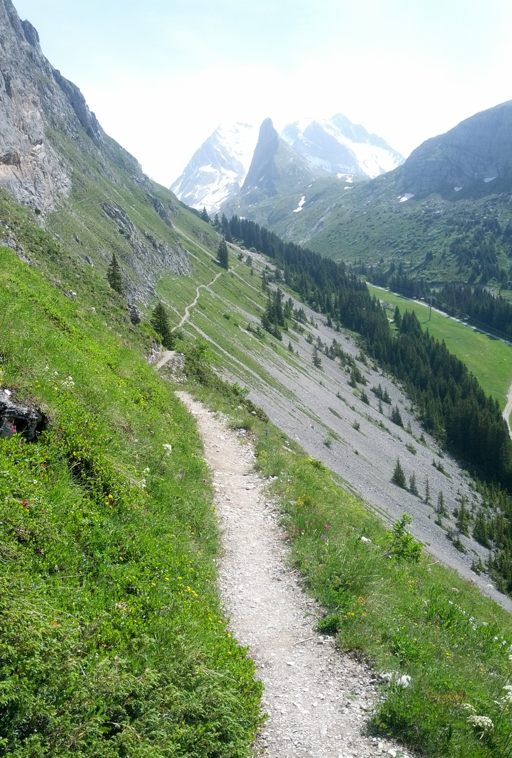
“You have made known to me the paths of life; you will fill me with joy in your presence”
ACTS 2:28
“I am the way, the truth and the life. No-one comes to the Father except through me”
JOHN 14:6, NKJV

Slide 5
Think
How would you describe your own faith pathway at the moment?
What are the challenges, barriers and distractions you face on your faith pathway?
Discuss
Who have been the people that have helped you on your faith pathway? How have they done that?
How can we help create healthy faith pathways for one another – and others who do not know Jesus?

Slide 6
Pray
Thank God for the people who have helped you to grow in your walk with Jesus.
Ask God to help you continue to grow in faith and clear your own pathway to be more like Jesus.
Act
What can you do this week to grow in your faith walk with Jesus?
Meet with a Christian friend to pray
Take time to read the Bible, pray and journal about your faith – the challenges, barriers and distractions
What is something you can do to help create a faith pathway for others?
Have coffee with a neighbour or new visitor to church and offer to pray with/for them
Invite people into your home for a meal
Host an Alpha course or small group in your home or church

