Slide 1



Investing ourselves in relationships that promote mutual flourishing
We find the wholeness God intends for us in community

Slide 2
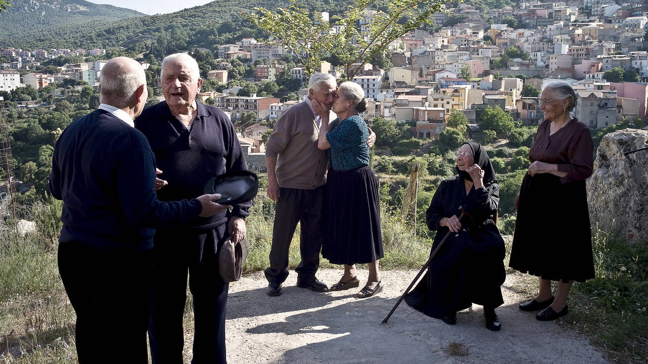

Slide 3
“The believers devoted themselves to the apostles’ teaching, to the community, to their shared meals, and to their prayers. A sense of awe came over everyone. God performed many wonders and signs through the apostles. All the believers were united and shared everything. They would sell pieces of property and possessions and distribute the proceeds to everyone who needed them. Every day, they met together in the temple and ate in their homes. They shared food with gladness and simplicity. They praised God and demonstrated God’s goodness to everyone. The Lord added daily to the community those who were being saved”
ACTS 2:42–47, CEB

Slide 4
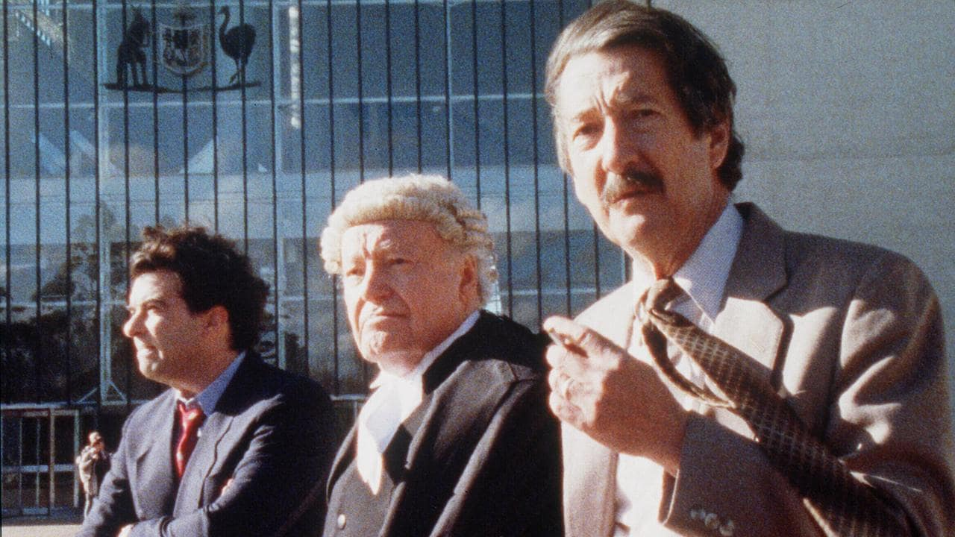

Slide 5
Investing ourselves in relationships that promote mutual flourishing
We find the wholeness God intends for us in community

Slide 6
Watch Video: Darwin Corps (2020)
https://www.youtube.com/watch?v=t5FtK5EcNFw

Slide 7
Think
What are some of the characteristics or “the vibe” of a healthy community?
What are some of the characteristics or “the vibe” of an unhealthy community?
Discuss
Share your reflections on healthy and unhealthy communities.
How can we help build a healthy Christian community in our church/corps?
How can we help contribute to building a healthy community in this area?

Slide 8
Pray
Thank God for the people in your church/corps working to build a healthy community.
Ask God to show you ways to serve others, be generous, listen and speak with
grace in your community.
Act
What is something you can do to help build a healthy Christian community?
Offer to pray with someone
Cook a meal for a new mum, a single parent or a person who is unwell
Send an encouraging text message to someone going through a difficult time
Offer to babysit a child so the parents can have a night out
Serve and build relationships at another mission expression in your area
Share a meal with someone who is new to the church
What is our Building Healthy Communities Local Mission Plan and how can I participate?

