Slide 1



Slide 2
Almighty God, who through your Son Jesus Christ overcame death and opened to us the gate of everlasting life: Grant that we, who celebrate with joy the day of the Lord’s resurrection, may be raised from death by your life-giving Spirit; through Jesus Christ our Lord; who lives and reigns with you and the Holy Spirit, one God, now and forever.
Amen

Slide 3
Luke 24:1–12
On the first day of the week, very early in the morning, the women took the spices they had prepared and went to the tomb. They found the stone rolled away from the tomb, but when they entered, they did not find the body of the Lord Jesus. While they were wondering about this, suddenly two men in clothes that gleamed like lightning stood beside them.

Slide 4
In their fright the women bowed down with their faces to the ground, but the men said to them, “Why do you look for the living among the dead? He is not here; he has risen! Remember how he told you, while he was still with you in Galilee: ‘The Son of Man must be delivered over to the hands of sinners, be crucified and on the third day be raised again.’” Then they remembered his words.

Slide 5
When they came back from the tomb, they told all these things to the Eleven and to all the others. It was Mary Magdalene, Joanna, Mary the mother of James, and the others with them who told this to the apostles. But they did not believe the women, because their words seemed to them like nonsense. Peter, however, got up and ran to the tomb. Bending over, he saw the strips of linen lying by themselves, and he went away, wondering to himself what had happened.

Slide 6
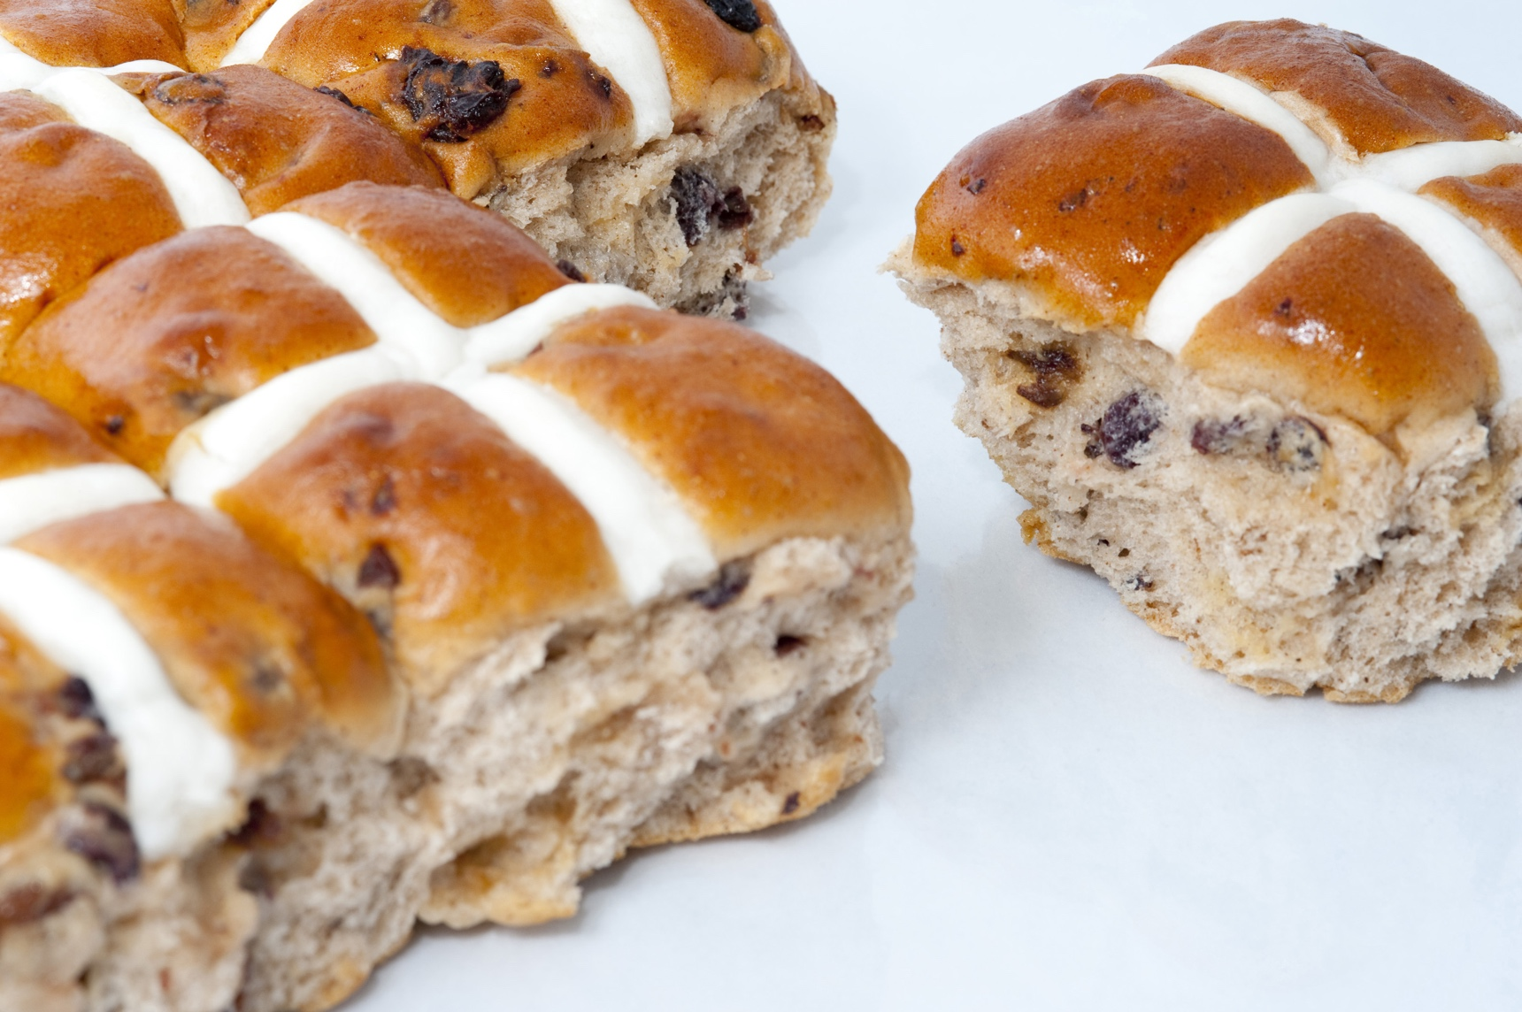
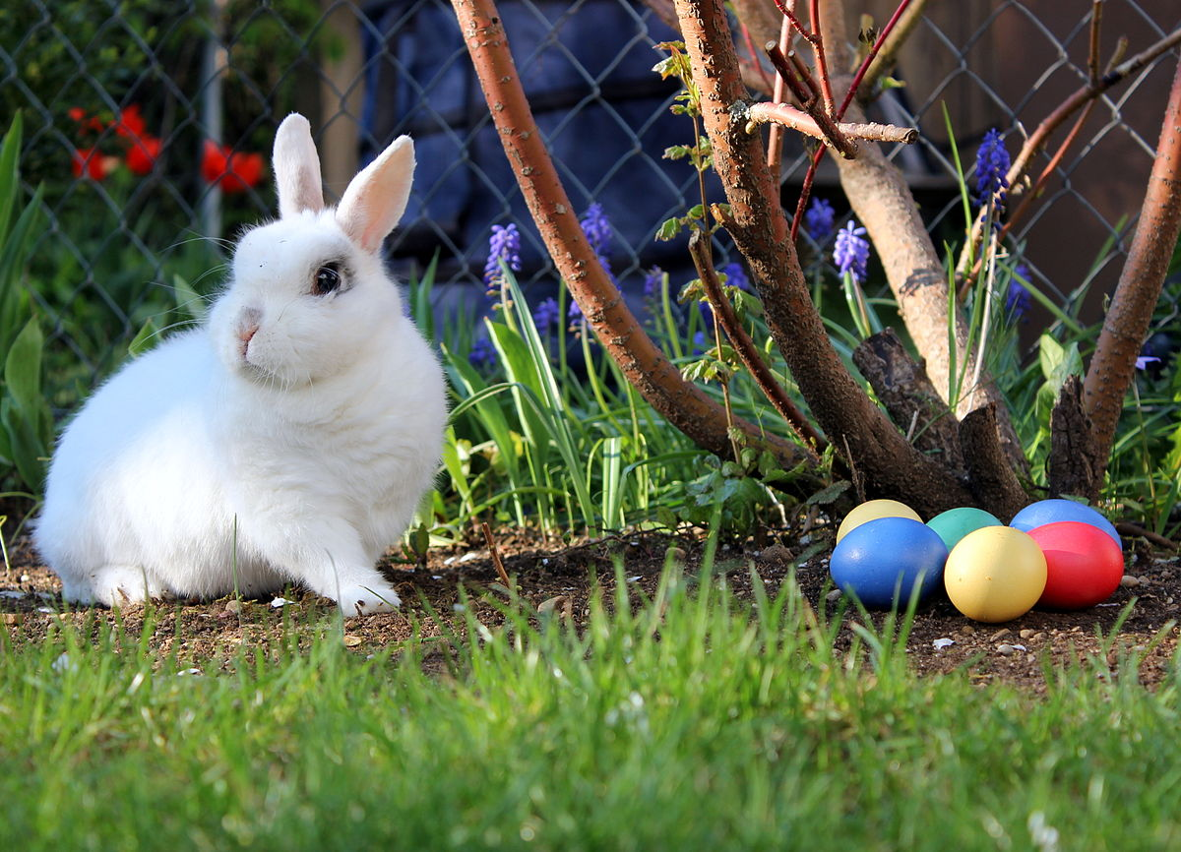
Meaningful hope in times of darkness

Slide 7
The resurrection of Jesus
is hard to believe

Slide 8
The resurrection of Jesus
had been predicted

Slide 9
And he said, “The Son of Man must suffer many things and be rejected by the elders, the chief priests and the teachers of the law, and he must be killed and on the third day be raised to life.” (Luke 9:22)
“Listen carefully to what I am about to tell you: The Son of Man is going to be delivered into the hands of men.” But they did not understand what this meant. It was hidden from them, so that they did not grasp it, and they were afraid to ask him about it. (Luke 9:44-45)

Slide 10
The resurrection of Jesus
changes everything

Slide 11
Easter Sunday is an opportunity to accept God’s grace
“The death he died, he died to sin once for all; but the life he lives, he lives to God. In the same way, count yourselves dead to sin, but alive to God in Christ Jesus” (Romans 6:10-11).

Slide 12
Christ is risen
We watch this Jesus
set deep in the grip of death
but not held
held overnight – but not held
held two nights – but not held
because the power of death could not hold him.

Slide 13
We know ourselves to be held
overnight
for two nights
too long
held by fear and anxiety
held by grudge and resentment
held by doubt and fatigue
held by too much stuff
by all manner of the forces of death.

Slide 14
Held, powerless
but turned toward you.
You are risen
make Sundays for us
even among us
even here
even now
no longer held. Amen.
(But not held – a poem/prayer by Walter Brueggemann)

Slide 15
THINK
What gives you hope in hard times?
SHARE
What would you say to someone confused about the resurrection of Jesus?
What difference does the resurrection of Jesus from the dead make for you?
PRAY
Thank God that he is the source of light and life and has defeated death.
Pray that you and others would know the power of the resurrection life.
Pray that God would bring hope to those who are feeling despair.

