Slide 1

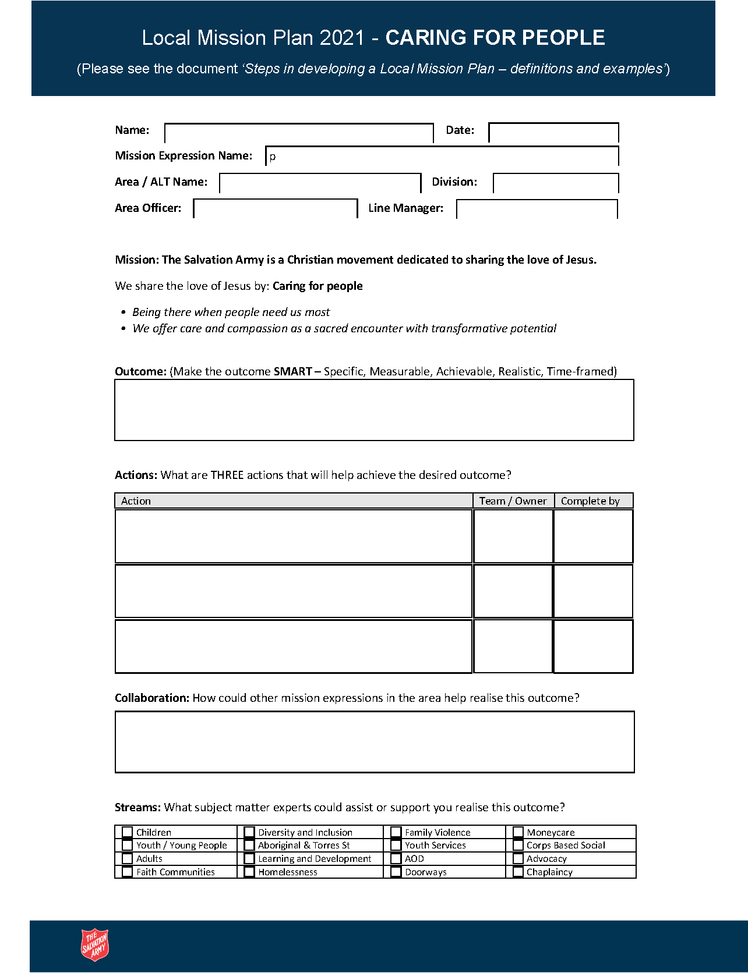
How we can think about living our mission and developing our Local Mission Plans?
February 2021

Slide 2

Guidelines for use
As a team, take some time to review your previous Local Mission Plan – to celebrate and thank the team and God.
The indicators here are a guide for your team to reflect on health and maturity in mission.
The indicators relate to mission expressions – not individuals.
Have a team discussion about mission and identify goals for the next 12 months
The Local Mission Plan includes the action steps to progress the expression from its current level of maturity. It is not limited to these measures.
Where we are
Where we want to be
Our Mission: Caring for people Creating faith pathways Building healthy communities Working for justice
Our Values: Integrity Compassion Respect Diversity Collaboration

Slide 3
Caring for People
Being there when people need us most – We offer care and compassion as a sacred encounter with transformative potential.
Little welcome of people relationally and /or lack of provision of warm and safe space.
Welcome people as 'clients' or 'customers' in a warm and safe space. Transactional relationship.
Intentionally build meaningful, mutually caring relationships for sustainable growth and transformation.
See and care for people holistically. Welcome, serve and listen respectfully.
Warmly welcome and actively listen to understand. See each person as precious and made in the image of God.
How are we caring for people?
Where do we see our expression on this measure of Caring for People and what has helped us identify this?
What do we think are 2-3 actions that could be taken by our expression to purposefully grow in caring for people?
How will our expression collaborate in ‘Caring for People’ that will have growing impact?
Our Mission: Caring for people Creating faith pathways Building healthy communities Working for justice
Our Values: Integrity Compassion Respect Diversity Collaboration
Notes:
Embed the Local Mission Delivery Operating Model to achieve effective and nationally consistent holistic integrated mission and to ensure that every mission expression reflects the full mission of The Salvation Army

Slide 4
Creating Faith Pathways
Taking a holistic approach to the human condition that values spirituality – We graciously share the good news of Jesus and grow in faith together.
How are we creating faith pathways?
No activities or programs provided for spiritual or faith exploration. No referral to other expressions.
Space and occasional opportunities provided for prayer and programs with some spiritual input( e.g. PLP) – warm referrals when appropriate.
Regular opportunities provided to explore Christian faith and spiritual questions (e.g. Alpha and small groups)
The community is intentionally engaged in holistic mission - prayer, evangelism, service and discipleship - able to tell stories of transformation
Regular opportunities and encouragement to explore Christian faith, spiritual questions and engage in holistic mission
Where do we see our expression on this measure of Creating Faith Pathways and what has helped us identify this?
What do we think are 2-3 actions that could be taken by our expression to purposefully grow in this area of mission?
How will our expression collaborate in ‘Creating Faith Pathways’ that will have growing impact?
Our Mission: Caring for people Creating faith pathways Building healthy communities Working for justice
Our Values: Integrity Compassion Respect Diversity Collaboration
Notes:
Embed the Local Mission Delivery Operating Model to achieve effective and nationally consistent holistic integrated mission and to ensure that every mission expression reflects the full mission of The Salvation Army

Slide 5
Building Healthy Communities
Engage with people with little understanding of their community or context.
See the local community as a community to be fixed by the provision of services.
Intentionally invest in relationships and building healthy communities for mutual growth and transformation.
See the Salvos as part of the resources of the local community - with a desire to partner with others in building community.
Actively engage, serve and listen to the many and diverse voices in the community. Actively engaging with others.
Investing ourselves in relationships that promote mutual flourishing – We find the wholeness God intends for us in community.
How are we building healthy communities?
Where do we see our expression on this measure of building healthy communities and what has helped us identify this?
What do we think are 2-3 actions that could be taken by our expression to purposefully grow in this missional intention?
How will our expression collaborate in ‘building healthy communities’ that will have growing impact?
Our Mission: Caring for people Creating faith pathways Building healthy communities Working for justice
Our Values: Integrity Compassion Respect Diversity Collaboration
Notes:
Embed the Local Mission Delivery Operating Model to achieve effective and nationally consistent holistic integrated mission and to ensure that every mission expression reflects the full mission of The Salvation Army

Slide 6
Working for Justice
Tackling the social systems that harm creation and strip away human dignity – We join God's work to build a fairer world where all can thrive.
Little interest or no evidence of working for justice
Awareness of injustice and some desire to address these injustices
Intentionally collaborating with others to see lives transformed and injustice addressed.
Deliberate conversations and some planning by a few members to work for justice
Growing numbers of people engaged in advocacy and looking to work for justice with others.
How are we working for justice?
Where do we see our expression on this measure of Working for Justice and what has helped us identify this?
What do we think are 2-3 actions that could be taken by our expression to purposefully grow in Working for Justice?
How will our expression collaborate in ‘Working for Justice’ that will have growing impact?
Our Mission: Caring for people Creating faith pathways Building healthy communities Working for justice
Our Values: Integrity Compassion Respect Diversity Collaboration
Notes:
Embed the Local Mission Delivery Operating Model to achieve effective and nationally consistent holistic integrated mission and to ensure that every mission expression reflects the full mission of The Salvation Army

