Slide 1
Developing Local Mission Plans
Before you look to the next year, take some time with your team to review your existing Local Mission Plan – to thank the team and celebrate what God has done.
This is a good time to briefly review the year together.
Then, discuss the following questions with your team to help develop your new Local Mission Plan.

Slide 2
Caring for people – questions to consider
The Salvation Army is far more than a 'hand out’,
it is a 'hand up' and a place of transformation and belonging.
How can we move from transactional models of assistance
to opportunities for transformation?

Slide 3
Caring for people: questions to consider
How do we care for our staff and corps members?
How do we care for our visitors and community members?
What has been working well in our mission expression?
What would we like it to look like?
How can we improve what we are doing?
What could we start doing?
What could we stop doing that has not been working?
How can we care for people engaged with other mission expressions?

Slide 4
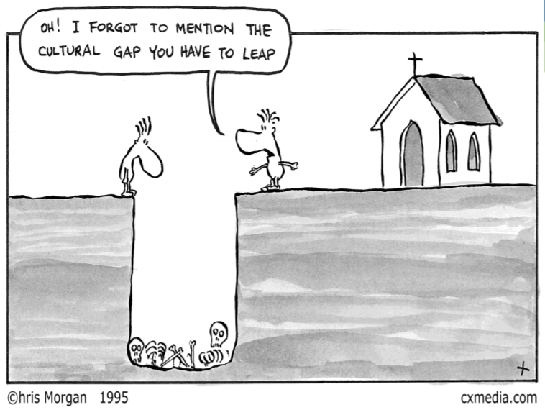
Creating faith pathways: questions to consider
How do we create opportunities for people to explore the Christian faith?
How do we help followers of Jesus grow in love and service of God and others?

Slide 5
Creating faith pathways: questions to consider
How do we help create faith pathways for people?
What has been working well in our mission expression?
What would we like it to look like?
How can we improve what we are doing?
What could we start doing?
What could we stop doing that has not been working?
How can we engage more with other mission expressions?

Slide 6

Building healthy communities: questions to consider
Not what is wrong but what is strong
How do we promote mutual flourishing in our Salvos community
AND
. . . contribute to building a healthy wider local community?

Slide 7
Building healthy communities: questions to consider
How do we help build a healthy Salvos community?
How do we contribute to building a healthy wider community for people?
What has been working well in our mission expression?
What would we like it to look like?
How can we improve what we do?
What could we start doing?
What could we stop doing that has not been working?
How can we engage more effectively with other mission expressions?

Slide 8

Working for justice: questions to consider
The Salvation Army will tackle unjust social systems through advocating for justice with government, business and the wider community.
How can we raise awareness of injustice and actively work alongside others for a more just world?

Slide 9
Working for justice: questions to consider
How do we work for justice?
Who do we partner with to work for justice?
What has been working well in our mission expression?
What would we like it to look like?
How can we improve what we do?
What could we start doing?
What could we stop doing that has not been working?
How can we engage more effectively with other mission expressions?

