Slide 1

Notes:
Introduction:
Hi, my name is [insert] and I work at The Salvation Army in [insert]. My role is [provide description].
Thank you for inviting me to speak today.
Today I’m going to be speaking with you for about 10 – 15mins about who The Salvation Army is and what we do to care for the community. Toward the end, I’ll talk about how your school is getting involved in our Christmas Appeal and how it is making a difference to those who might be struggling.

Slide 2

Notes:
First, I would like to acknowledge the Traditional owners of the land we meet [land] and pay respect to Elders past, present and future.

Slide 3
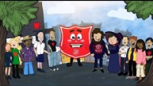
Notes:
Who are The Salvos?
First, put your hands up if you have heard of The Salvation Army before?
Here’s a video to learn more about us.
WATCH: https://www.youtube.com/watch?v=cgd9wAqyaBA

Slide 4

What did Shieldy say about
The Salvos’?
Notes:
Q. What did Shieldy say about The Salvos?
Take a few student responses and then summarise the video.
Add an explanation here about the local The Salvation Army services and programs.

Slide 5

Notes:
Here is some of the work that we do. *BRIEFLY explain service (1min approx)

Slide 6



Last year, The Salvos provided over 1.67 million instances of support in Australia.
Notes:
Each year, The Salvos provide over 1 million instances of support in Australia.
We have been there for people in Australia for over 140 years.

Slide 7
How does the Salvos help our local community?
Notes:
Here, talk sensitively to the services that your Mission Expression provides. You could list your services, go through your weekly schedule – and share what you do to support your local community
***Include appropriate photos where possible!

Slide 8

2024 has been a tough year for many Australians.
Costs such as groceries, petrol and housing have increased and it means many people are struggling to make ends meet.
This Christmas, the Salvos need to help more people than ever before
Notes:
2024 has been a tough year for many Australians. The cost of daily living expenses have increased and people are struggling to afford everything to meet their needs. That means we have been helping people with their grocery shop or supporting them through a difficult time.
This year, the demand for our support at Christmas is expected to be bigger than ever.
Which is why we are asking for your help!

Slide 9

Christmas Appeal
We need your help to ensure nobody struggles alone this Christmas.
Everyone deserves to experience the magic of the holidays or sit down to a nice meal. Please help us as we support those in need in our community.
Notes:
Your school has kindly offered to support us by taking part in our Christmas Appeal.
We are asking you to donate [food/toys/money] that we will use to ensure no one goes without in [suburb name] community. At Christmas each year, many people turn to us for support. Through the items you donate/money you raise, we will work to ensure no one is hungry, people have a special meal to look forward to and people have the opportunity to enjoy some of the magic of Christmas.
Q. If someone is struggling to get by and then they receive a Christmas hamper with food – how will it make them feel? Cared for, happy, loved, supported. That’s what The Salvos are all about.
Note: grocery graphic sourced under creative commons license
https://pixabay.com/vectors/market-icon-supermarket-store-food-5043870/

Slide 10
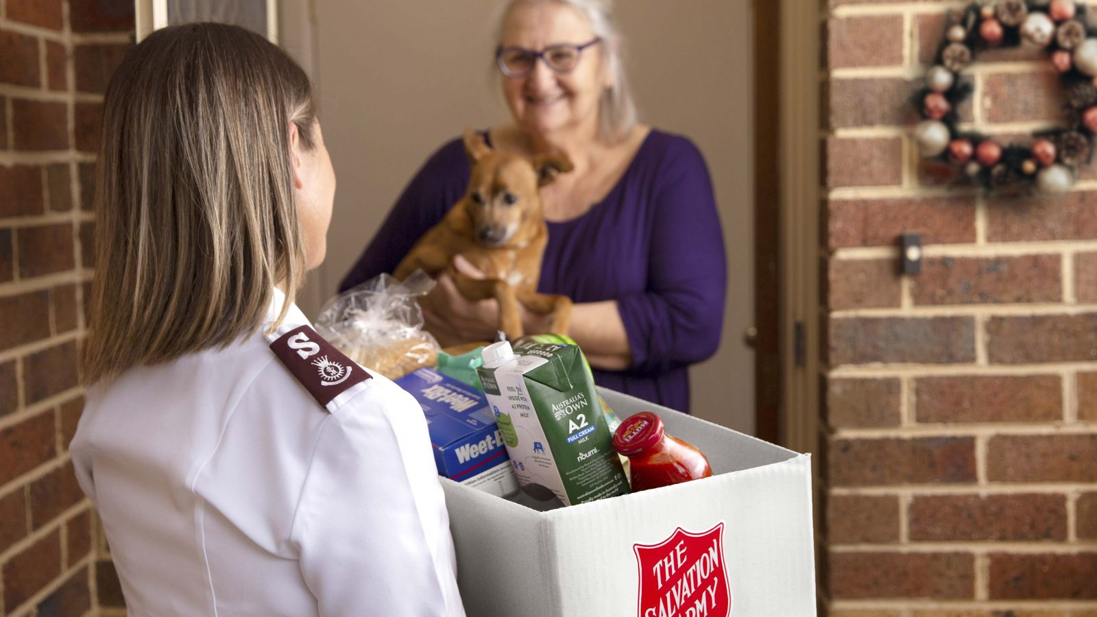
What to donate?
Notes:
Give example for [Food/Gifts].
Provide guidance on giving such as…
• Please make sure all items being donated are new/unused unopened
• Please ensure items have long expiry dates and are non-perishable (Ask a student to define ‘non-perishable’)
• Consider providing food that will suit families with young children, people with allergies, the elderly and new Australians

Slide 11

Christmas Appeal
Your gift really does
make a difference.
Thank you for your generosity.
Notes:
Your gift really does make a difference.
For items: “We will collect your donated items and make sure they give hope where it’s needed most.”

Slide 12

We’re here for you!
The Salvation Army is a place where you can get help and give hope to others.
salvationarmy.org.au
Notes:
We’re here for you.
The Salvation Army is a place where you can get help and give hope to others.
You can look us up online at salvationarmy.org.au.

Slide 13
Give a new beginning this Christmas…
Notes:
Are there any questions?
Thank the school sincerely for their support.

