Slide 1

Notes:
Introduction:
Hi, my name is [insert] and I work at The Salvation Army in [insert]. My role is [provide description].
Thank you for inviting me to speak today.
Today I’m going to be speaking with you for about 10 – 15mins about the work of The Salvation Army, our support locally in [region] and how your school is supporting us through our Christmas Appeal.

Slide 2

Notes:
[Welcome/Acknowledgment of Country] First, I would like to acknowledge the Traditional owners of the land we meet [land] and pay respect to Elders past, present and future.
The Salvation Army is a Christian movement grounded in bringing hope to people who may be experiencing hardship or injustice. You don’t need to be a Christian to engaged with us, seek support volunteer, or be employed in our work, but at our core, we are united by faith. The Salvation Army is a place where all people are valued and welcomed.

Slide 3

For over 140 years, The Salvation Army has been giving
hope where it’s needed most.
Notes:
*If a small audience, you may like to ask ‘who has heard of The Salvos before’ or ‘where have you seen our Shield before?” follow up by asking students if they know what The Salvos do and then positively encourage and debrief.
We are a leading social service provider in Australia and the largest provider of homelessness services. We have locations all across Australia (and internationally) and provide a number of care services, often specific to the needs of the local community where we are present.

Slide 4
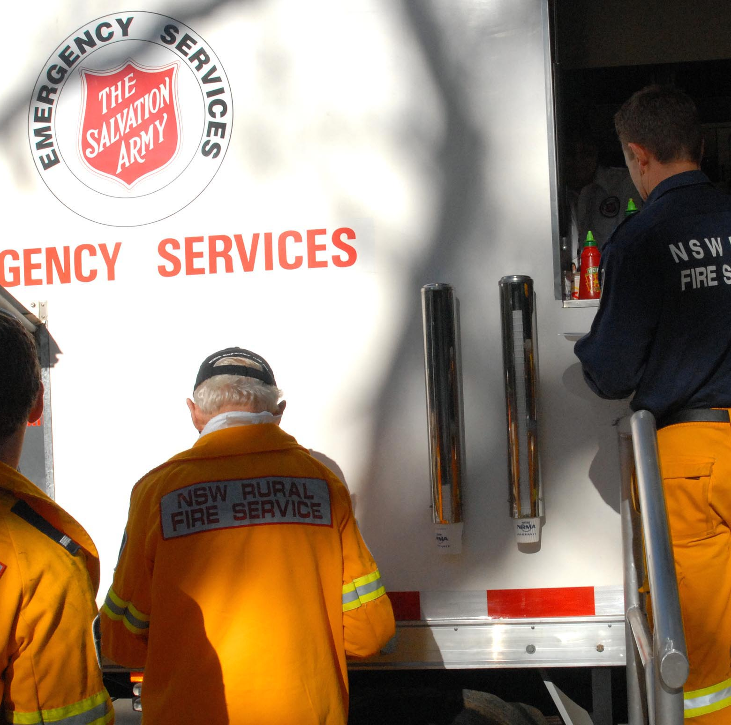
What we do:
community services
homelessness services,
youth services
family and domestic
violence services
addiction recovery programs
chaplaincy
emergency and disaster
response services
Notes:
Many people know about The Salvos because of our Salvos Stores, or our support to people experiencing homelessness. We also run:
community services, youth services, family and domestic violence services, addiction recovery programs, chaplaincy, emergency and disaster response services
Salvos Stores help us generate the funds we need to provide the support that we do.

Slide 5
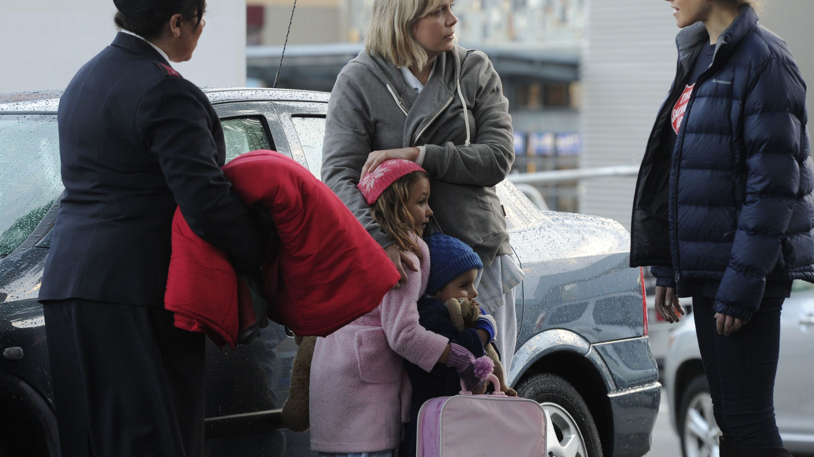
In FY 2022-2023, we provided…
Over 1.67+ million sessions of care
Over 1.2 million nights of accommodation
Supported more than 36,000 people seeking employment
Notes:
In the last year…
*1.67mil sessions of care provided
Over 1.2 million nights of accommodation
Supported 36000people seeking employment
Assisted more than 10,000 people experiencing domestic and family violence

Slide 6
More than ever, Australians are calling on The Salvation Army for support.
Notes:
Now, with the rising cost of living, many people are struggling to make ends meet. We are expecting to support more people than ever this Christmas.

Slide 7
The work of The Salvation Army locally…
Notes:
Here, talk sensitively to the services that your Mission Expression provides. You could list your services, go through your weekly schedule – and share what you do to support your local community
***Include appropriate photos where possible!

Slide 8
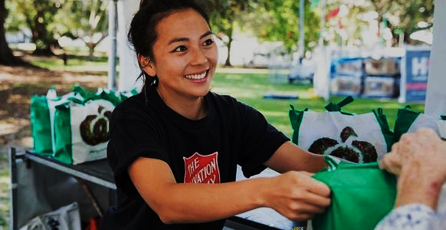
We need your help
Every donation counts. You can help us ensure no one is left in need.
Notes:
This year, your school is supporting our Christmas Appeal. You're invited to donate (clothes/toys/money) that we will distribute to those most in need within our local community.

Slide 9
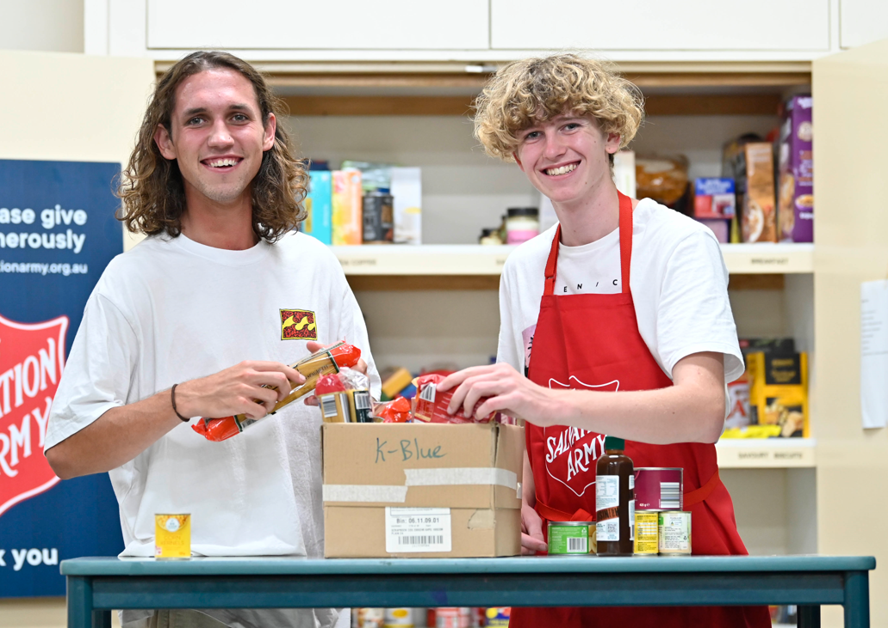
The Salvos believe in good for your Christmas – and you can too…
Notes:
When people are struggling to get by, food can be one of the first things to go. More than 50% of people who seek our support are skipping meals each day* No one should go hungry and everyone deserves to experience the magic of the holidays.
Whether it’s enabling an isolated person a Christmas meal, ensuring families can access some special ingredients for a holiday dinner, or providing a gift for someone in need, your donation will help people feel valued.
(source:https://www.salvationarmy.org.au/about-us/news-and-stories/media-newsroom/surge-in-australians-sinking-into-extreme-poverty-amid-cost-of-living-crisis-salvation-army-research-reveals/)

Slide 10
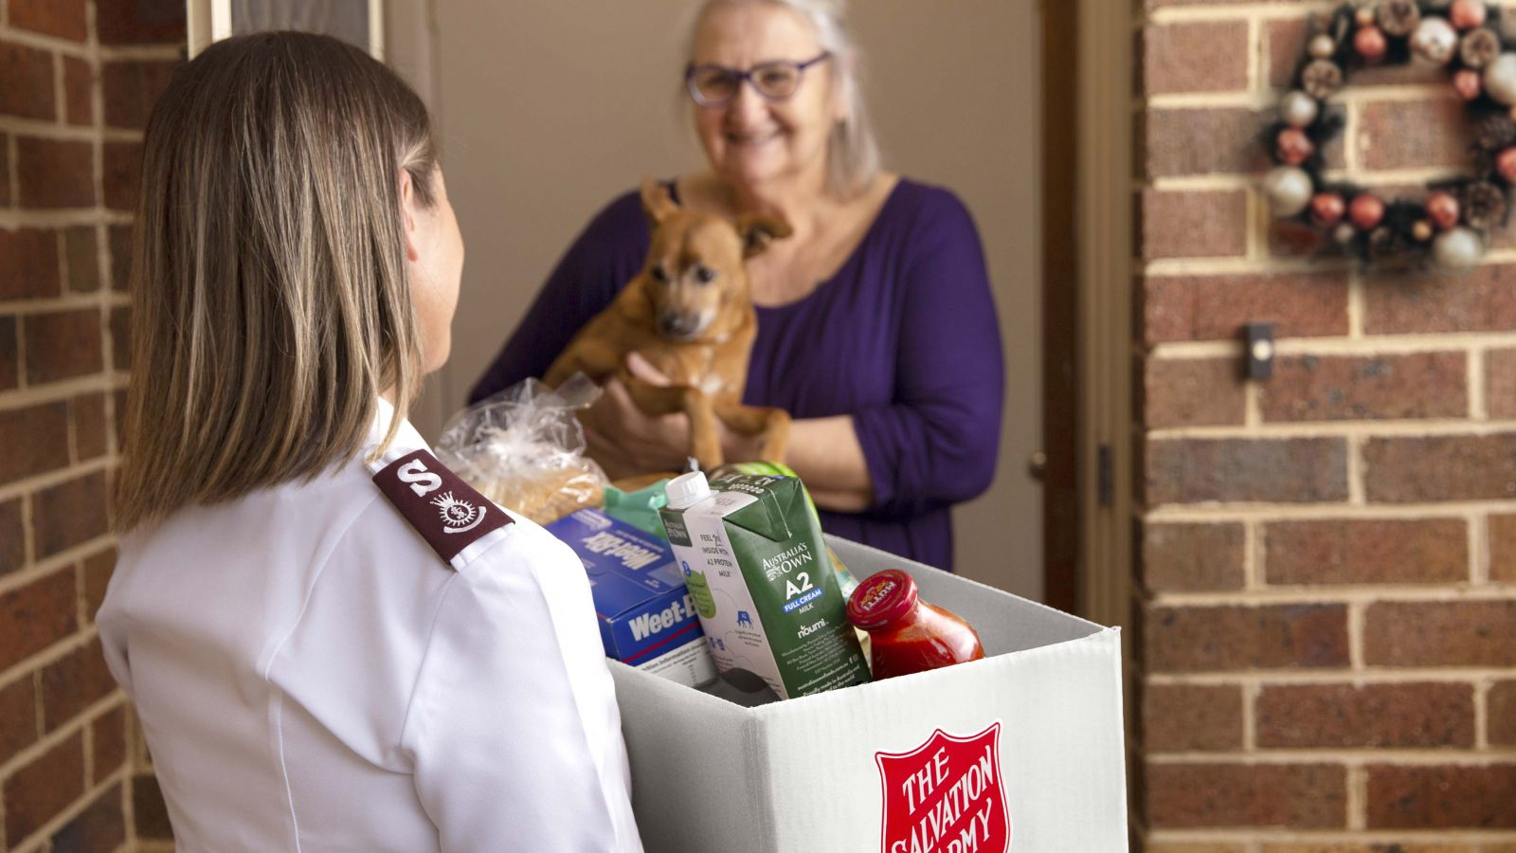
What to donate?
Notes:
Give example for [Food/Gifts].
Provide guidance on giving such as…
• Please make sure all items being donated are new/unused unopened
• Please ensure items have long expiry dates and are non-perishable (Ask a student to define ‘non-perishable’)
• Consider providing food that will suit families with young children, people with allergies, the elderly and new Australians
Consider gifts for a variety of age groups. Ask yourself what you’d like perhaps?
**if financial donation – talk about how the money will be spent or some of the 'Wishes' on the Wishes online Fundraising platform
Your gift really does make a difference

Slide 11
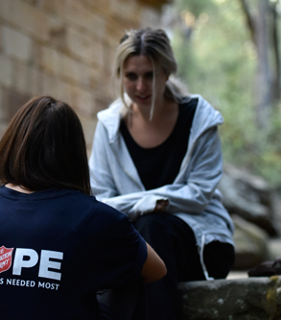
We’re here for you
The Salvation Army is a place where you can get help and give hope to others. salvationarmy.org.au facebook.com/TheSalvationArmyAustralia
Notes:
We’re here for you.
The Salvation Army is a place where you can get help and give hope to others.
We believe in good.
You can look us up online at salvationarmy.org.au and on Facebook.
Add information here about any local initiatives for young people and school students, such as volunteering (appropriate to the context of the school).

Slide 12
Give a new beginning this Christmas…
Notes:
*Any questions?
*Thank the school sincerely

