Slide 1


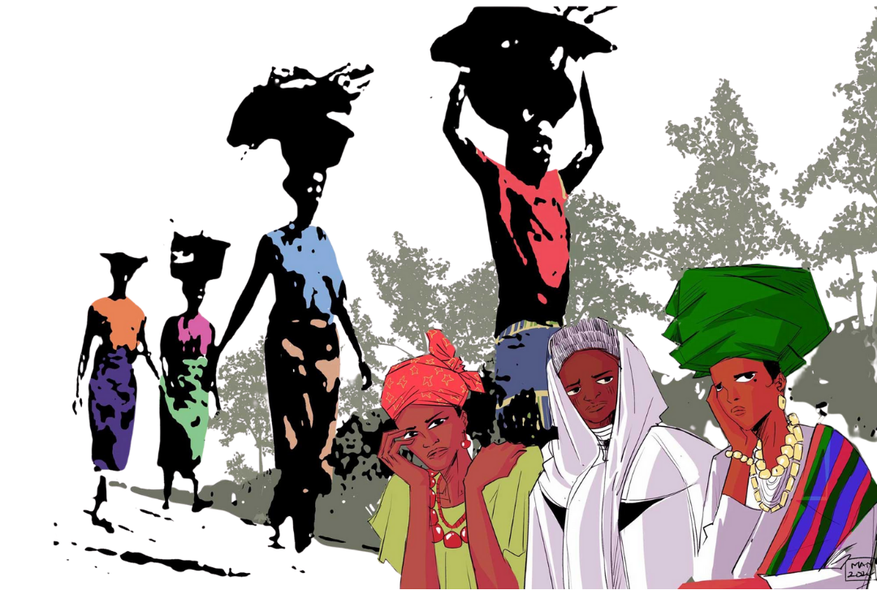
Nigeria 2026

Slide 2
Come to me, all you who are weary and are carrying heavy burdens, and I will give you rest. Take my yoke upon you, and learn from me, for I am gentle and humble in heart, and you will find rest for your souls. For my yoke is easy, and my burden is light.

Slide 3
Leader: We are now invited to respond to Jesus' words: Come to Jesus, all who are weary.
All: We come.
Leader: Come to Jesus, all who are carrying heavy burdens.
All: We come.
Leader: God will give you rest.
All: God will give us rest.

Slide 4
Leader: Take on the yoke that Jesus offers.
All: We receive his yoke.
Leader: Learn from the one who is gentle and humble in heart.
All: We are here to learn.
Leader: You will find rest for your souls.
All: Thanks be to God.

Slide 5
Chioma's story

Slide 6
Leader: Compassionate God, we hear your invitation to come and find rest for our souls.
We often shy away from your call, knowing that we have added to people's burdens by our selfish words or actions. Whatever our age, hurtful words and selfish actions can undermine people's confidence and lead to insecurity, injustice and hatred.

Slide 7
Leader: We are sorry for not living your best way for us. Grant forgiveness when we go astray and bring healing to those we have hurt. As we draw closer to you, fill our hearts with love for you, our neighbours and ourselves.

Slide 8
All: Thank you for your assurance of forgiveness. Help us to walk your way, giving hope and encouragement to others and bringing you glory.

Slide 9
Leader: God of the insecure, open our ears to hear, our hearts to feel and our minds to understand. You are the one who invites us to come and find rest.
Loving Jesus, you walked this earth and know what it is to be a child. Be with all children who struggle today, at home, in school and in situations beyond their control.

Slide 10
Leader: Holy Spirit, enable us to provide safe and secure environments for children to grow and flourish. Bring healing for all our hurtful memories.
All: Stir us to powerful, faithful prayer and unite us across continents in compassion and hope. Amen.

Slide 11
Beatrice's story

Slide 12
Leader: God of the marginalised, we know that you see us. You see the discrimination faced by so many: those who are overworked; those exploited in factories, fields and homes; and those who cannot find work to feed their families. Thank you, Gracious God, for the resilience and resourcefulness of all who remain faithful amidst difficult circumstances. Inspire us by their example and move us to build a better world.

Slide 13
All: God of the marginalised, intervene for us all.
Leader: Loving Jesus, you welcomed the oppressed and lifted up the downtrodden. Today we see injustice everywhere and many suffer under oppressive systems. Speak to the hearts of all leaders, that they may govern with fairness and compassion. Move the hearts of communities to change their attitudes and actions towards all who are marginalised.

Slide 14
All: Loving Jesus, give us strength to keep trusting you, even when the burdens seem too heavy to bear.
Leader: Holy Spirit, fill us anew. Let your power overflow in our communities. Use us to be a blessing to others. May we be inspired by those who use their own struggles to bless those around them. Thank you for hearing our cries and bearing our burdens.
All: Holy Spirit, we trust in your unfailing love and your mighty power to transform. Amen.

Slide 15
Jato's story

Slide 16
Leader: God of the persecuted and protector of the faithful, we come before you with heavy hearts and confess the sins that tear at the fabric of our society: the intolerance that breeds fear, the hatred that fuels violence and the indifference that allows injustice to persist. Comfort those who live with the fear of losing loved ones, and change the hearts of the perpetrators, guiding them toward reconciliation.

Slide 17
All: God of Justice, we cry out against extremism which spreads violence. Break every chain that binds us and separates us from our neighbours. Touch the hearts of all, showing them the value of human life and the path to peace.

Slide 18
Leader: Loving Jesus, you too faced persecution. We lift up Leah Sharibu and all who suffer for their beliefs. Grant them strength and comfort in their darkest hours, inspiring us to stand strong in the face of adversity. Help us take up your yoke of love and forgiveness.

Slide 19
All: Loving Jesus, renew our minds and hearts, guiding us in righteousness, that we may honour you and bless others. We trust in your power to transform.
Leader: Holy Spirit, we cry out for those displaced by violence, forced to flee their homes and become refugees in unfamiliar lands. In the face of persecution, let us not simply await rescue; instead encourage us to actively live out our faith, knowing that each act of love and forgiveness is a testament to Christ's enduring power in our lives.

Slide 20
All: Holy Spirit, shelter under your wings all who are displaced, providing for their needs and guiding them towards safety and new beginnings. Amen.

Slide 21
Blessing's story

Slide 22
Leader: God of the poor, we cry out to you to help families who are struggling to meet their basic needs. We give thanks and praise for the persistence of Blessing and Grace and all those who keep moving forward despite even the most difficult circumstances.
All: God, Giver of Life, continue to strengthen and comfort all who are weary from the burdens of life and direct the hearts of those who can help.

Slide 23
Leader: Loving Jesus, compassionate healer, we lift up those who live with poor mental health, often made worse by poverty, stress and daily life. Walk with them and show them that their lives have immeasurable value. Help us to create societies that respect and care for all.
All: Loving Jesus, you called us to come with all the burdens that weigh us down. Here we are! Help us to cast our cares on you and lighten these loads.

Slide 24
Leader: Holy Spirit, be our Comforter in times of distress. Grant us the faith to keep moving forward even when the path seems impossible. When we cannot see a way forward, be our guide.
All: Help us to be a light to others, sharing hope and extending a helping hand where we can. We trust in your promise that you will never leave us or forsake us. Amen.

Slide 25


Slide 26


Slide 27


Slide 28


