Slide 1
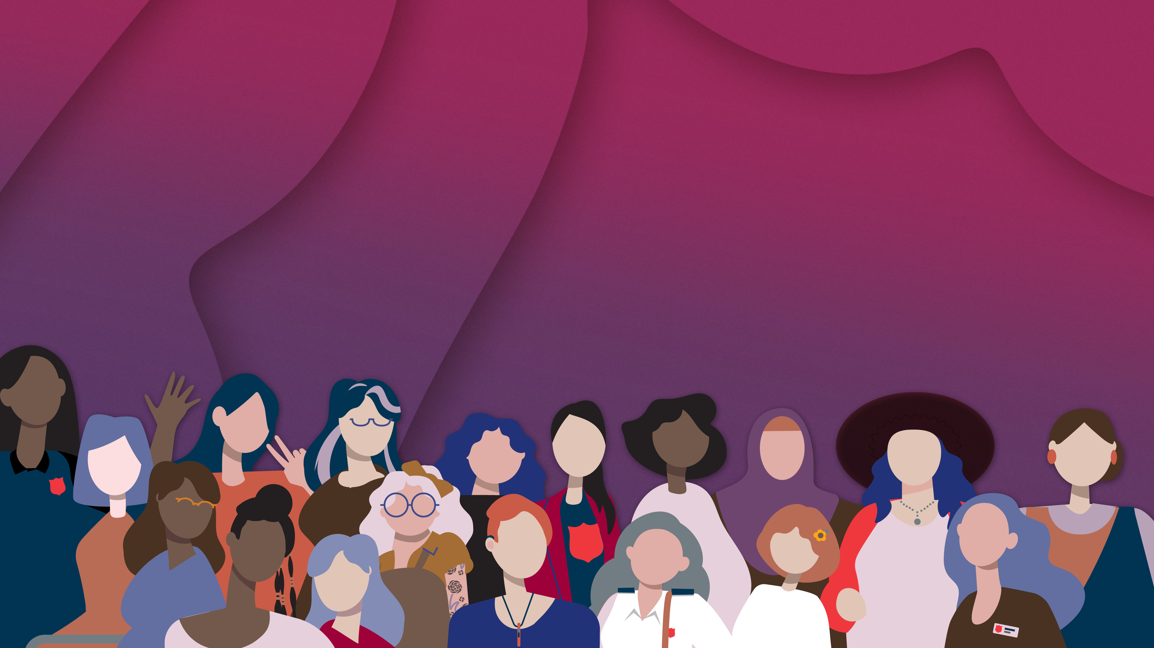



Slide 4
International Women's Day
March 8 [2026]

