Slide 1
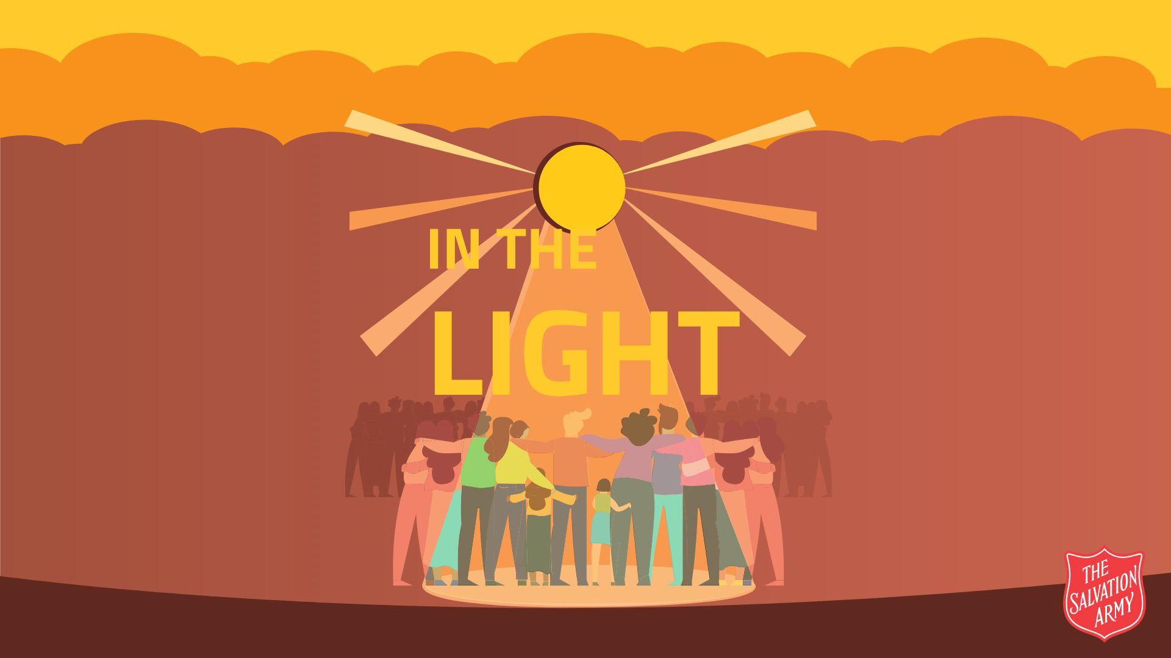

Slide 2

But Jesus said, “Let the little children come to me. Don’t stop them, because God’s kingdom belongs to people who are like these children.”
Matthew 19:14 (ERV)

Slide 3

Leader: Almighty God, thank you for the gift of children and teenagers. You are the one who cares for children and young people. You are a God of justice and our defender. We gather in your presence to lift before you the young people of the world – their joys, their fears, and their needs.

Slide 4
All: Hear our prayer; enfold every child in your love.
Leader: Gracious God, we give you thanks for every child and young person who is growing in their knowledge of your love in Jesus.
All: Thank you for new life in Christ.

Slide 5
Leader: Thank you for the joy, courage, and faith we see in young hearts – for small deeds of kindness, bold acts of service, and honest prayers.
All: We praise you, Lord, for their witness.

Slide 6
Leader: God of peace, help young people who struggle with anxiety, bullying and loneliness at school.
All: Lord, help our young people to know your loving presence with them each day.

Slide 7
Leader: God of peace, where guns and bombs have broken homes and disrupted childhoods, bring shelter to the frightened, comfort to the bereaved, and an end to violence.
All: Lord, protect the children; turn the hearts of leaders toward life and peace.

Slide 8
Leader: Merciful God, expose every network of child trafficking, break the chains of exploitation, and deliver children from those who would profit by their suffering.
All: Lord, restore the stolen childhoods; give survivors courage and healing.

Slide 9
Leader: Inspire governments, churches, and communities to pursue justice and provide places of safety and hope.
All: Lord, help us to work for rescue and restoration.

Slide 10
Leader: God of wisdom, for young people who have been denied schooling through poverty, discrimination or displacement, open doors of learning and imagination.
All: Lord, raise up teachers and provide resources within safe schools; let no child be left behind.

Slide 11
Leader: Healer of all, we remember the young people who suffer from malaria, malnutrition, preventable diseases. We mourn the loss of infants whose lives were brief.
All: Lord, bring healing hands; strengthen fragile bodies and weary parents.

Slide 12
Leader: God of compassion, sustain parents and caregivers under pressure: those struggling, grieving, or displaced. Fill communities with resources and solidarity.
All: Equip us to be protectors and providers; let children grow up in safe homes.

Slide 13
Leader: Raise up mentors, foster families and faith communities that cherish and defend children everywhere.
All: Lord, may love and responsibility abound.

Slide 14
Leader: In all the beauty and pain of this world,
All: we give you thanks for your steadfast love and care.

